Slide 1
Employee Data Analysis using Excel
STUDENT NAME: LEJWANTHI.GP
REGISTER NO: asunm13332213331042032
DEPARTMENT: COMMERCE
COLLEGE: BHARATHI WOMEN’S COLLEGE

Slide 2
PROJECT TITLE
Employee Performance Analysis using Excel

Slide 3


AGENDA
Problem Statement
Project Overview
End Users
Our Solution and Proposition
Dataset Description
Modelling Approach
Results and Discussion
Conclusion
3/21/2024 Annual Review

Slide 4

PROBLEM STATEMENT
Tracking The Performance Of Employees In the Company, Then we can able To Focus On The Growth Of The Company.
By Motivating The Lower Performing Employee, To Perform Well In Future.
By Motivating The Higher Performing Employee, By Providing Them Increments, Promotion ,etc..

Slide 5

PROJECT OVERVIEW
Objective: Analyze employee performance data to identify key factors affecting productivity and efficiency.
Methodology: Utilize statistical analysis and machine learning models to uncover trends, patterns, and correlations
Insights: Provide actionable recommendations for enhancing employee performance management strategies.
Visualization: Use data visualization techniques to present findings in a clear and accessible manner.
Deliverables: A detailed report, actionable insights, and a dashboard for continuous performance monitoring.

Slide 6

WHO ARE THE END USERS?
Customers & Clients
Vendors / Suppliers
Employees
Partners

Slide 7

OUR SOLUTION AND ITS VALUE PROPOSITION
Conditional Formatting – To Find Out The Missing Values
Formula – To Find Out The Performance Level Of Employee
Pivot Table – For Summary
Graph Chart – For Data Visualization

Slide 8
Dataset Description
Employee Dataset Taken From Kagglle
There are 26 Features & Details Of Employees
We Are Only Considering Some Features Like ;-
Employee Id – As Numerical Values
Name Of The Employee- In Text
Employee Type – Full Time/Part Time
Performance Level Of Them – High/Low
Gender Code – Female/Male
Employee Rating - As Numerical Values
Using Pivot Summaries The Data

Slide 9

THE "WOW" IN OUR SOLUTION
Formula To Find Out The Performance Level :
=IF(AA2>4,”VERY HIGH”,AA2>3,”HIGH”,AA2<4,”MED”)
3/21/2024 Annual Review
9

Slide 10
MODELLING
Data Collection – Kaglle
Download File
Align File
Total Features 26
Collected Data 6
Conditional Formatting for Find Out Missing Values
Formula (IF) For Find Out The Performance Level
Categories The Perfomance Level As Very High , High & Med
Pivot Table To Summaries The Data
Graph Chart For Visual Presentation
10

Slide 11

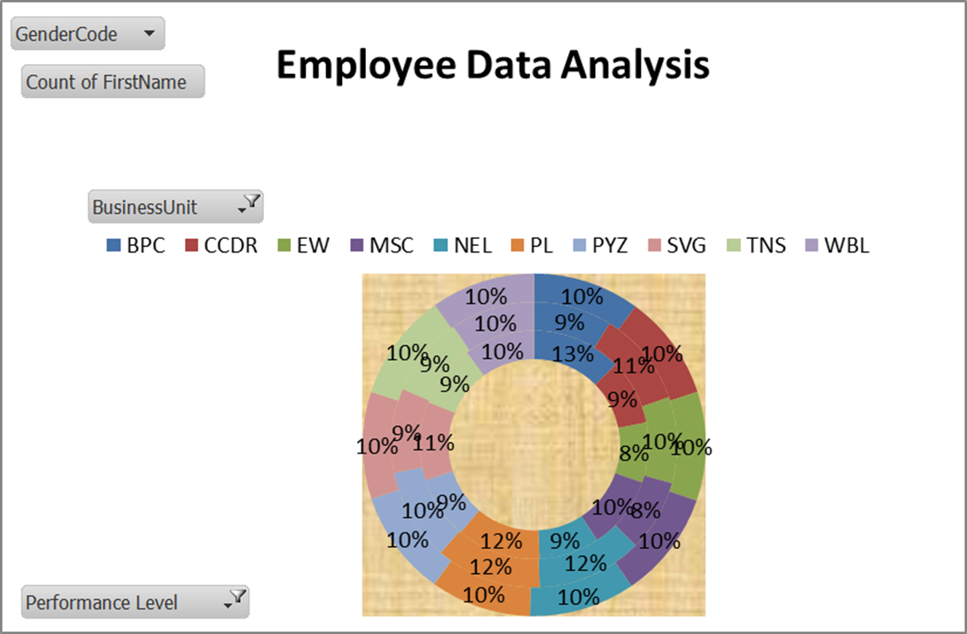
RESULTS
Very high
High
Medium
11

Slide 12
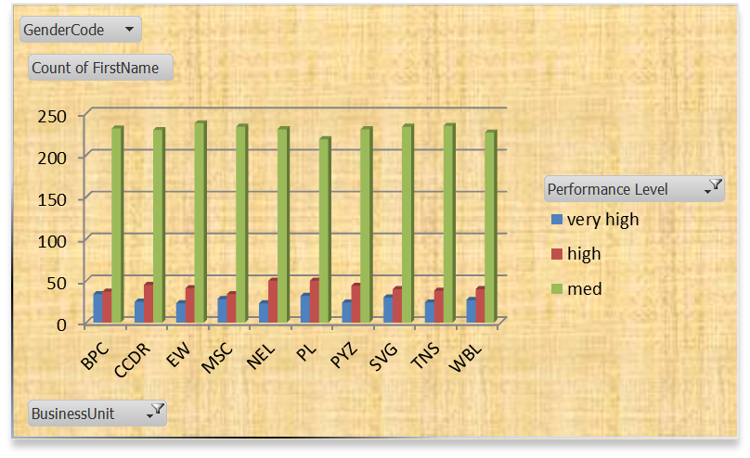
conclusion
Overall Employee Data Analysis

